Slide 1


MADRID
REAL ESTATE ANALYSIS
Vinit Solanki
Click here for video

Slide 2

Dataset Overview
Overview: This dataset provides comprehensive information on residential property listings in Madrid, Spain. It is used to explore market trends, investment opportunities, and feature-based pricing patterns using Power BI.
Key Dataset Details: Total Records: [Insert count after data load] Location Covered: Madrid, Spain
Primary Columns:
id – Unique listing identifier
house_type_id – Categorical property type
price – Listing price in Euros
sq_mt_built – Built area in square meters
has_pool, has_garden, is_exterior, is_new_development – Property features
loan_int_rate – Implied loan interest rate
is_duplicated – Indicates repeated listings
Data Notes:
Contains duplicate listings, flagged by is_duplicated
Missing and corrupted values in text columns (e.g., house types)
Needs transformation in Power Query before modeling and visualization
Rich feature set supports segmentation, correlation, and trend analysis

Slide 3

Price Analysis Based on Property Features
Objective :
To analyze the effect of Pool, Garden, and New Development features on average property prices.
Approach :
Cleaned and transformed feature columns using Power Query
Created DAX measures to calculate average price per feature
Used bar charts and matrix visuals in Power BI to compare pricing patterns
Key Findings :
Pool: Properties with pools have the highest average prices, indicating strong premium value.
New Development: Higher prices observed, reflecting modern design and buyer preference.
Garden: Moderate price increase, especially in suburban areas.
Conclusion :
Properties with a pool have the strongest correlation with higher prices, followed by new developments.

Slide 4
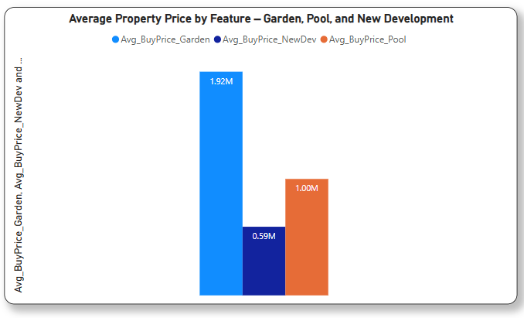
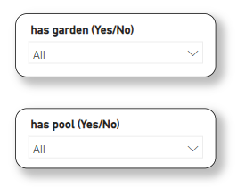
Impact of Property Features on Average Price
Overview This analysis explores how specific property features—such as having a pool, garden, or being a new development—influence the average property price in Madrid. By identifying which features drive higher prices, we gain valuable insights into buyer preferences and market trends.
Approach Calculated the average prices for properties with each feature using Power BI Visualized the differences through a clear, comparative bar chart Enabled slicers for interactive exploration across regions and property types
Insights
Properties with a garden have the highest average price: €1.92M
Homes with a pool come next with an average price of €1.00M
New developments are priced more affordably, averaging €0.59M
Conclusion The presence of a garden has the strongest impact on property price, making it a top-value feature in the Madrid housing market. This suggests that outdoor space is highly desirable, especially in urban residential areas. Property investors and developers can use this insight to prioritize features that boost value.

Slide 5
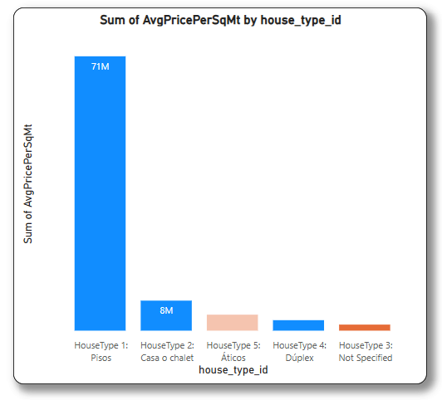
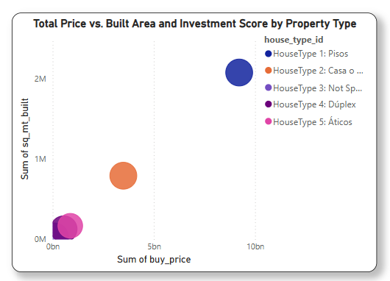
Top 5 Investment Opportunities by House Type
Overview
This slide analyzes property types using house_type_id to understand price trends and investment distribution. Metrics like average price per square meter and total purchase value provide insights into market dynamics and investment scale.
Approach
Segmented properties by house_type_id
Analyzed AvgPricePerSqMt to assess pricing trends
Mapped Total Price vs. Built Area in a bubble chart to gauge investment volume and property scale
Used visual weight to highlight key property types
Insights
HouseType 1 (Pisos) dominates in average price per square meter (71M), showing high market pricing density
HouseType 2 (Casa o chalet) shows moderate average price per square meter (8M), indicating a mid-range investment tier
HouseType 5 (Áticos) and HouseType 4 (Dúplex) have lower pricing, suggesting more affordable entry points
Conclusion
Segmenting properties by type reveals Pisos (HouseType 1) as the most significant in terms of both pricing and investment volume. While Casa o chalet also holds investment value, Áticos and Dúplex appear less prominent in current market dynamics. These insights can guide investors towards property types with stronger financial positioning and market presence.

Slide 6
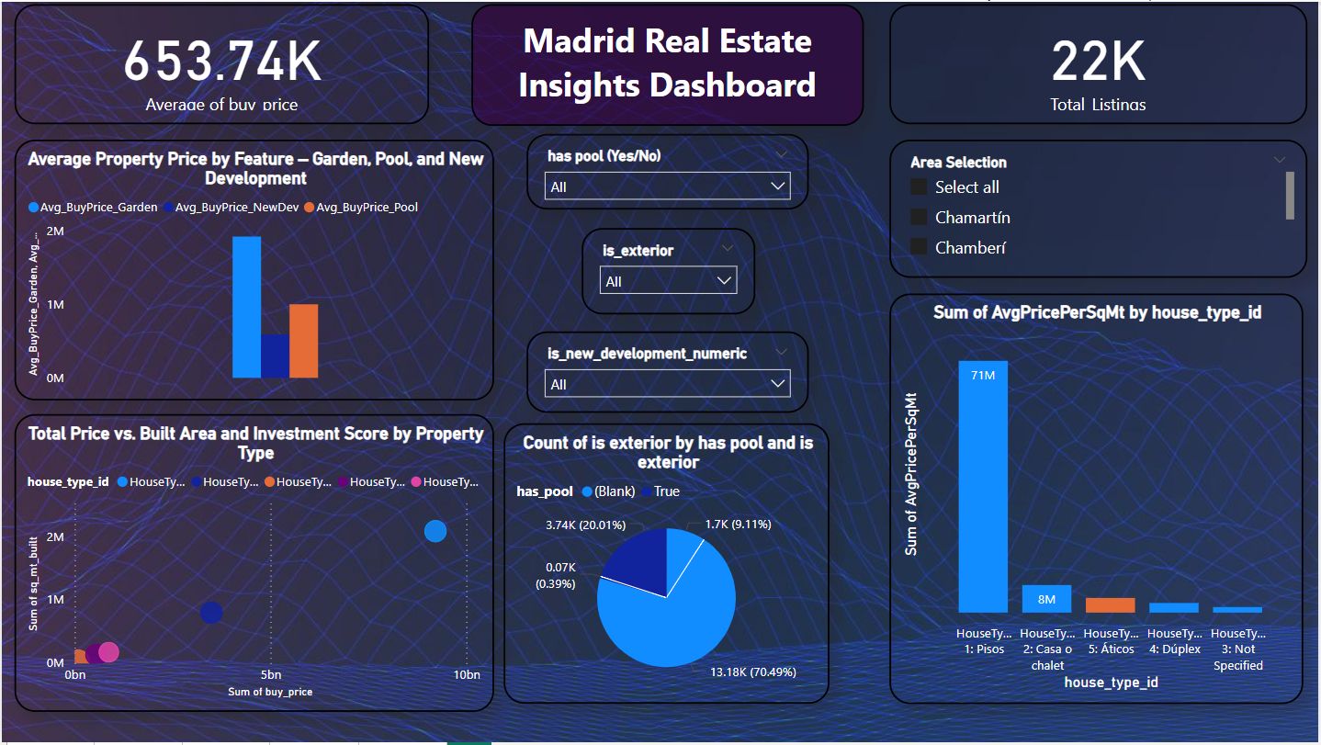
DASHBOARD

Slide 7

THANK
YOU!

